Slide 1
Gene sequencing technologies

Slide 2
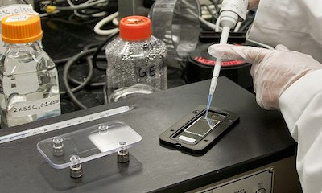
Microarray technology
Can sequence thousands of genes at a time
Order to quantify the expression of genes
Microarray chip which contains probes at different locations on its surface that can bond to target DNA.
The bonding of probes and targets is referred to as hybridization

Slide 3
Types of Microarrays
DNA Microarray | Preparation
Spotted | These arrays use a poly-lysine coated microscope slide. A robotic arm dips a small tip into DNA and then onto the glass surface to fluorescently label the sample. The probes need to be synthesized prior to chip preparation.
in-situ | These arrays use light or photolithography to create probes on the chip. These probes are oligonucleotides that match known sequences of target DNA.
Self-Assembled | These arrays use fiber optics. DNA is assembled on small polystyrene beads. These beads are then attached to a fiber optic which creates wells slightly larger than the beads. Some versions contain wells already premade in a glass to hold the beads. The beads are encoded with different combinations of fluorophore, so the randomly assembled oligos are identified by their specific combinations, as opposed to the other arrays in which the positions are known.

Slide 4
Spotted arrays were the first arrays to be created.
They are the most straightforward to use and are relatively inexpensive. Spotted arrays allow the user to check for the purity and quantity of the DNA or cDNA to be used.
This, however, can prove to be time-consuming as the DNA or RNA have to be extracted, converted into cDNA (in the case of RNA), and purified.
in-situ arrays are faster than spotted arrays and do not need cDNA handling.
They only require that the target sequence be known.
They also have high specificity, as opposed to spotted arrays where cross-hybridization can occur.
in-situ arrays, however, are rather costly and require specialized machinery to synthesize the arrays themselves.

Slide 5
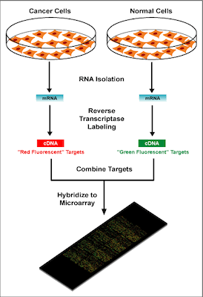
DNA Microarray Analysis
There are four main steps to a DNA microarray analysis:
Sample isolation/preparation,
Hybridization,
Washing
Analysis.

Slide 6
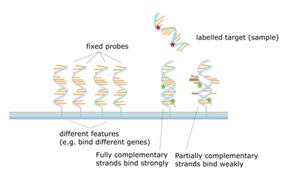
Sample isolation & preparation | This step requires the control and target mRNA to be extracted - i.e., a non-cancerous cell line versus a cancerous cell line, respectively. The RNA is then converted into cDNA and labeled with a fluorescent dye. Typically, Cy3 (a red fluorescent dye) and Cy5 (a green fluorescent dye) are used to label the target and control cDNA.
Hybridization | In this step the sample DNA is hybridized with complementary probe sequences on the array chip. DNA will strongly or weakly hybridize - or not at all (Figure1). The resulting complex is also purified at this step.
Washing | Slides are then washed with buffer to remove any DNA that did not strongly hybridize to a probe. This also helps prevents cross hybridization - hybridization by sample and probe that are not complementary.
Analysis | In the final step, the array chip is exposed to laser excitation showing the relative abundance of hybridized DNA in each target location. Fluorescent emission is measured using a confocal microscope.
Figure 1. Probes are fixed to the chip surface and targets are added. The targets bond to probes with a complementary sequence. Targets that did not hybridize - or hybridize weakly - are removed after the slide is washed.

Slide 7
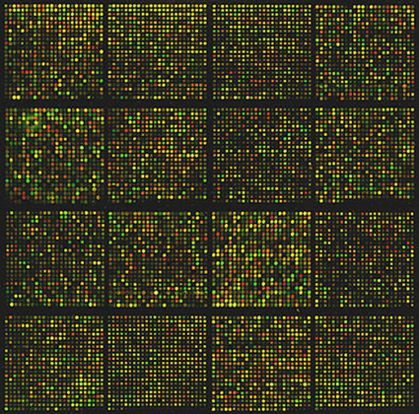
Analysis
The resulting image of an array chip can be seen in Figure Typically, red represents areas of downregulation, green represents areas of upregulation, and yellow represents areas where the target and control samples have the same expression. Faded areas could signify spots with low cDNA concentration.

Slide 8
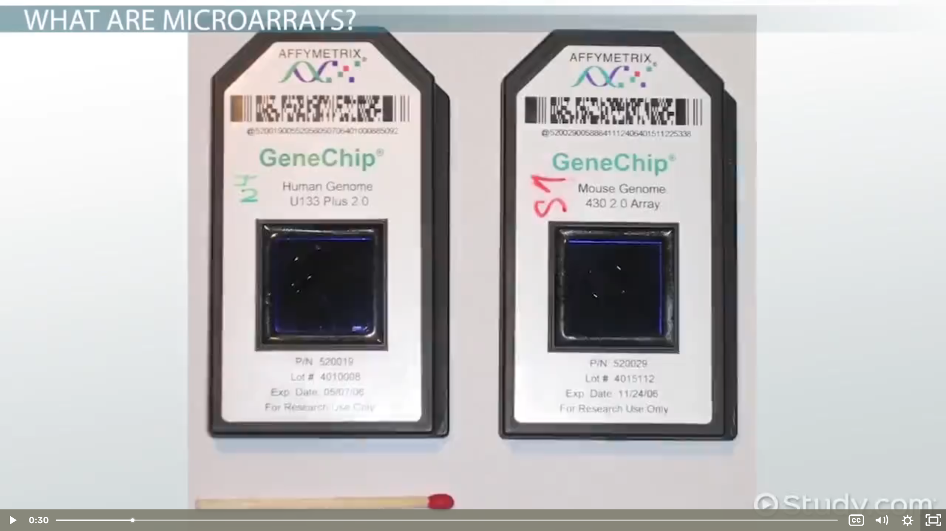


Slide 9
Drawbacks
Only work with known genes
Unable to find new genes/genomes/sequencing
Indirect method
Reproducibility issues
Preparation time
Unble to detect low frequencty variants and mutations

Slide 10
NGS
Direct method
High throughput and reproducibility
Cost effective
Sequencing thousands of genes and genomes
Directly sequencing unknown genomic fragments and genomes
Able to sequence large number of samples
To detect low frequency varients

Slide 11
Applications
NGS
Genomics
Transcriptomics
Epigenetics

Slide 12
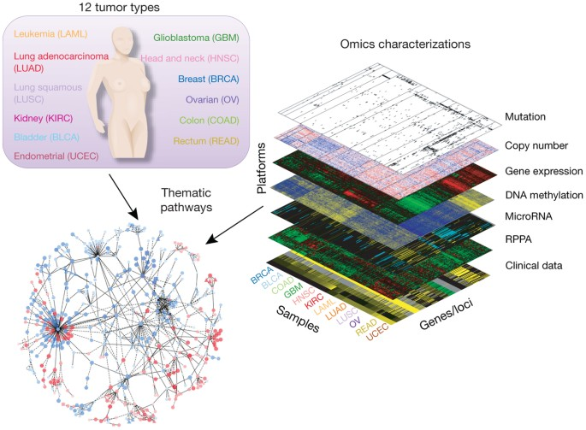
App: Transcriptomics
Measurement of gene expression level of all genes
Sequencing all mRNA molecules of the cell
Discovery of novel transcripts/proteins
Investigating cluster of genes related to diseases like Cancer
The Cancer Genome Atlas (TCGA) project

Slide 13
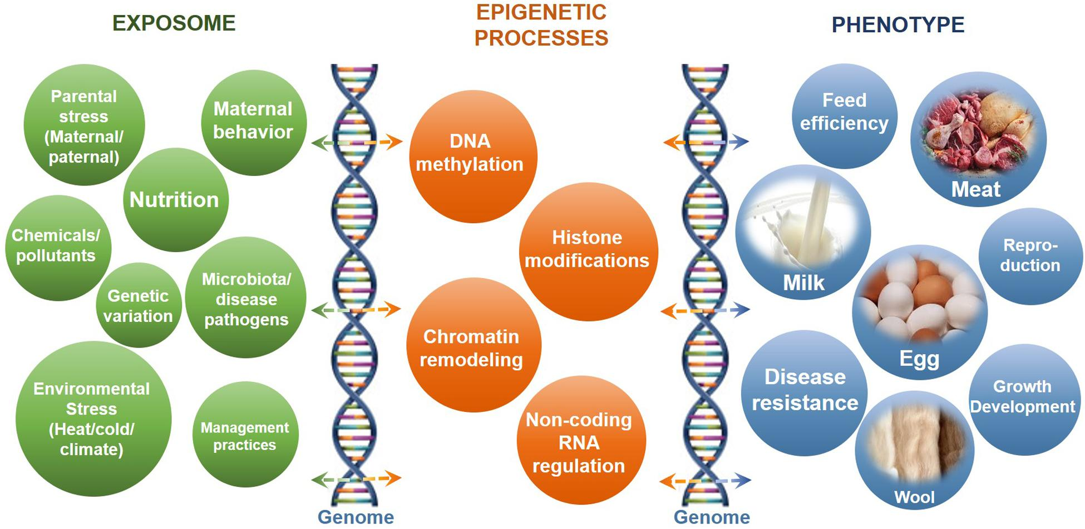
App: Epigenetics

Slide 14
App: Metagenomics
Microbial metabolic activity through soil based organisms, aquatic bacterial, Gut biome
Clinical- pollutants and their effect on health

